Slide 1

Analyze Image Classification for Simple Shapes
Information Technology Course
Module Software Engineering
by Damir Dobric / Andreas Pech
By: Bolutife Adisa
Matric no: 1400418

Slide 2
Contents
Introduction
Experiments and Results
Training Phase
Prediction Phase
Conclusion

Slide 3
Introduction
Project Goal: To conduct tests and find the best parameter combination for achieving accurate similarity between simple images of basic shapes.
Determining optimal parameter combination
Develop a function for predicting untrained input images belonging to the same basic shapes.
Software Program: Hierarchical temporary memory (HTM)
What is HTM?
How do we apply it in this project?

Slide 4
Training Phase
Dataset selection: Factors to be considered include:
position of the object in the images,
the orientation (angle)
the size of the object in the images.
Circle Square Triangle Star

Slide 5
Training Phase
Fetch image folder
Loop all the images
Train each image 1by1with spatial pooler
Find similarity for active columns of input vectors and output SDRs
Spatial pooler should enter the stable state
Correlation matrix of input and output similarity

Slide 6
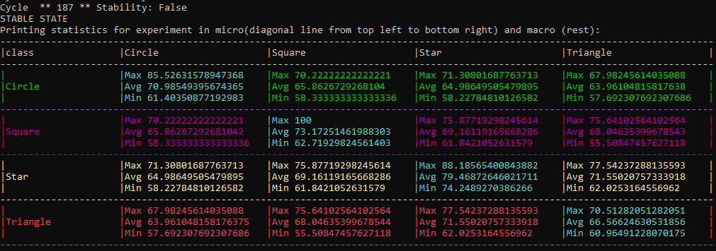
Training Phase
Best output:
Potential radius 10,
Local Area Density 0.3
and Local Inhibition -1.0

Slide 7
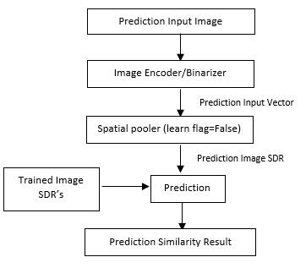
Prediction Phase
Flow chart of prediction phase

Slide 8
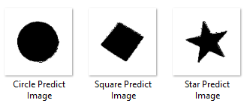

Prediction Case1 – Test 1
A circle image is used as Input predict image, theoretically belongs to the trained dataset.
The training model can predict the feature in the prediction image as circle with an average similarity of 73.26%
Prediction Output

Slide 9

Prediction Case1 – Test 2
Similar to the testcase1, a rectangle image is used for the prediction testing, belongs to the training dataset
The training model can predict the feature in the prediction image as square with an average similarity of 71.07%
Prediction Output

Slide 10

Prediction Case 2
A star shaped image is input for prediction and theoretically the similarity values between the trained shapes show be very low.
From the prediction result, we can state that the feature of the star image used for prediction results in low average values for the trained dataset classes.
Prediction Output

Slide 11
Conclusion
From the experiments, the results shows that how spatial pooler parameters influence for an efficient learning of the dataset.
Similarity between the images is controlled by the LocalAreaDensity and numActiveColumnsPerInhArea parameters for effective learning.
The Image Dimensions influence the Potential Radius
For a higher LocalAreaDensity value, the active columns will be increased in spatial pooler, resulting is higher similarity between different classes.
Further, the trained data is used for feature prediction of any given input image.

Slide 12
References
[1] | "Numenta" [Online]. Available: https://numenta.com/resources/biological-and-machine-intelligence/spatial-pooling-algorithm/.
[2] | D. S. D. Sundari, "Hierarchical Temporal Memory Image Classification".
[3] | D. Dobric, "GitHub," [Online]. Available: https://github.com/ddobric/neocortexapi-classification.
[4] | O. Rukundo, "Effects of image size on deep learning," [Online]. Available: https://arxiv.org/ftp/arxiv/papers/2101/2101.11508.pdf.
[5] | Z. C. Y. Q. Z. Y. Y. X. Wen Zhuo, "Image classification using HTM cortical learning algorithms," [Online]. Available: https://ieeexplore.ieee.org/document/6460663.
[6] | H. J. a. G. D., "Hierarchical Temporal Memory: Concepts, Theory, and Terminology.," [Online]. Available: http://www.numenta.com/Numenta_HTM_Concepts.pdf.

